Slide 1

Clinical test maintenance
Shivakumar
Shivam Sharma
Veeresh
Pavan
Ganavi
Rajkumar

Slide 2



Introduction
XDiagnostics labs, one of the famous pathology labs in Raipur, is known for its accurate results and research works. Due to the reputation earned over the years the patients visiting the diagnostic center was increasing tremendously. But for the last two years the management has noticed a decline in the percentage increase of patients year on year which was slowly emerging as a significant issue. The below are given the requirements decided for the upcoming system:

Slide 3
Requirment
Create a screen with Login Id and Password. Check for the distinct roles and restrict access to perform the specified operations. (I.e., User cannot Modify/Delete values.). User types are Admin and User.
Read the requirements carefully; Use appropriate fields and normalize the database wherever necessary.

Slide 4
Tables
Test type [test_id ,test_type]
Sample types[sam_id, sam_type]
Department[dep_id ,dep_name]
User and Admin[id, name ,type]

Slide 5
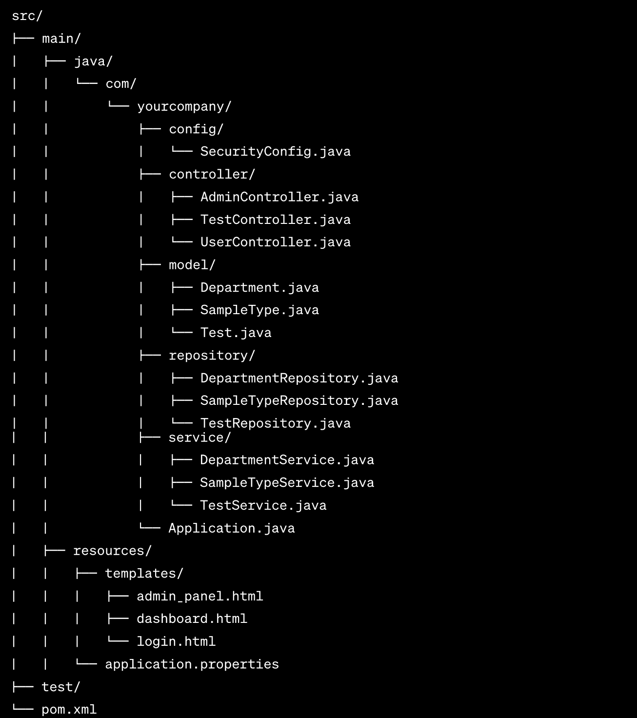
File structure

Slide 6
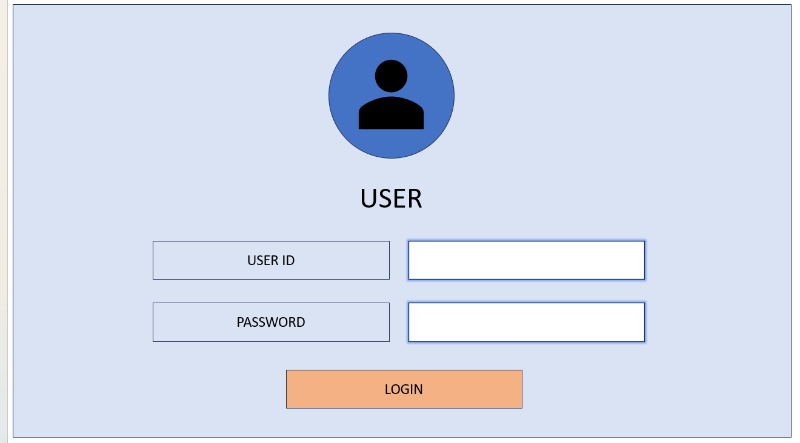
FrontEnd

Slide 7
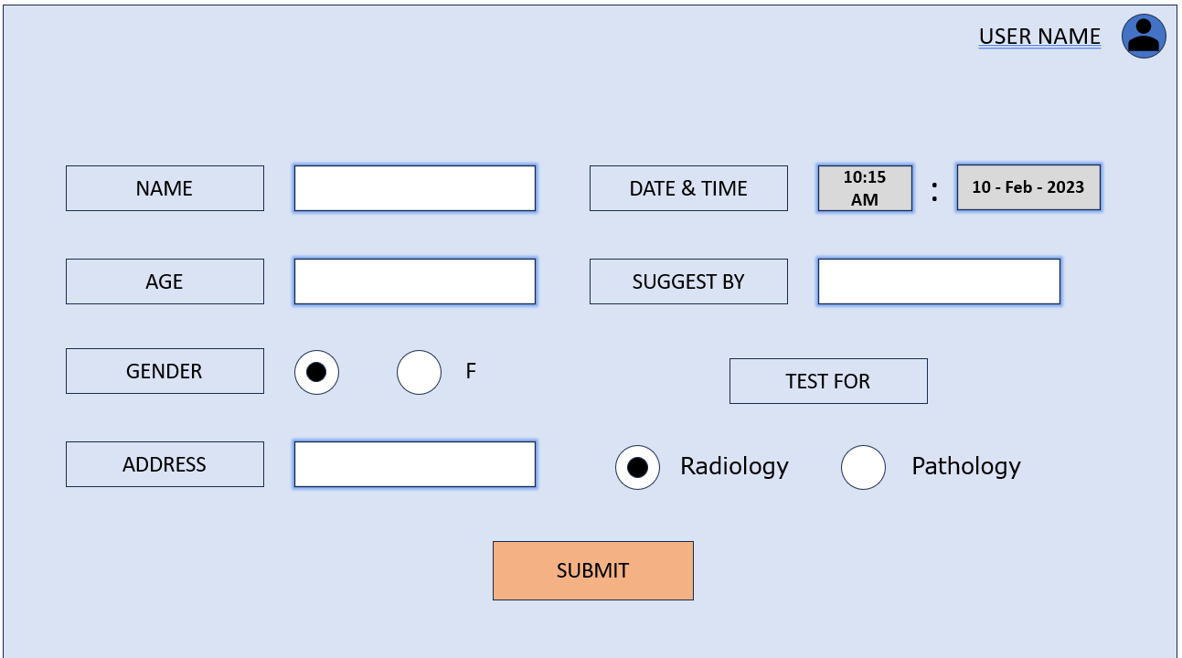

Slide 8
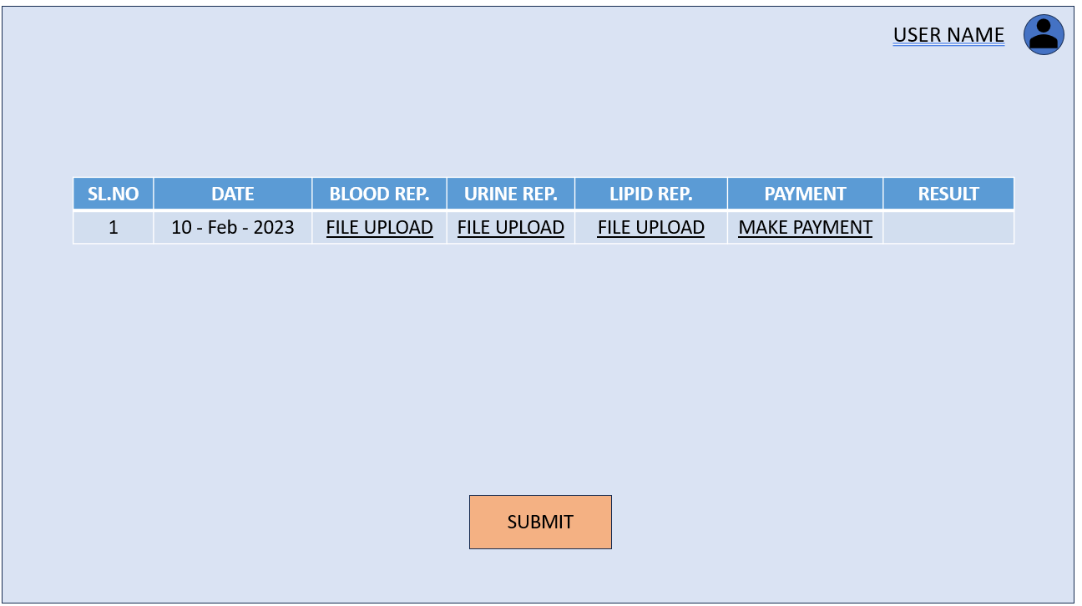

Slide 9
Thank you

